Slide 1



World Electricity
Analysis
Project by: Group-3D
Jitendrasingh Rao
Meena Vadadoriya
Simaran Raghuvansh
Supriyam Mishra

Slide 2
What is Electricity?

Slide 3
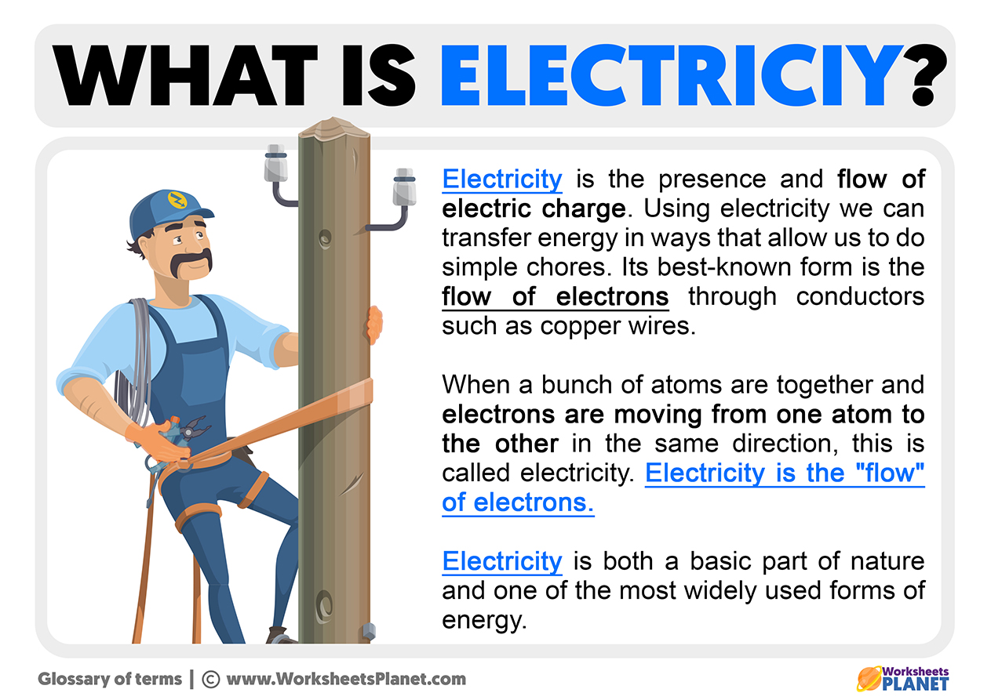
What is Electricity?
Electricity is a form of energy
OR
Electricity is the flow of electrical power or charge.
Types:
Static
Current
Produced From:
Renewable Sources: Solar,Hydro,Wind,etc
Non-renewable Sources: Coal, Oil, Natural Gas,etc

Slide 4
Project at a Glance

Slide 5
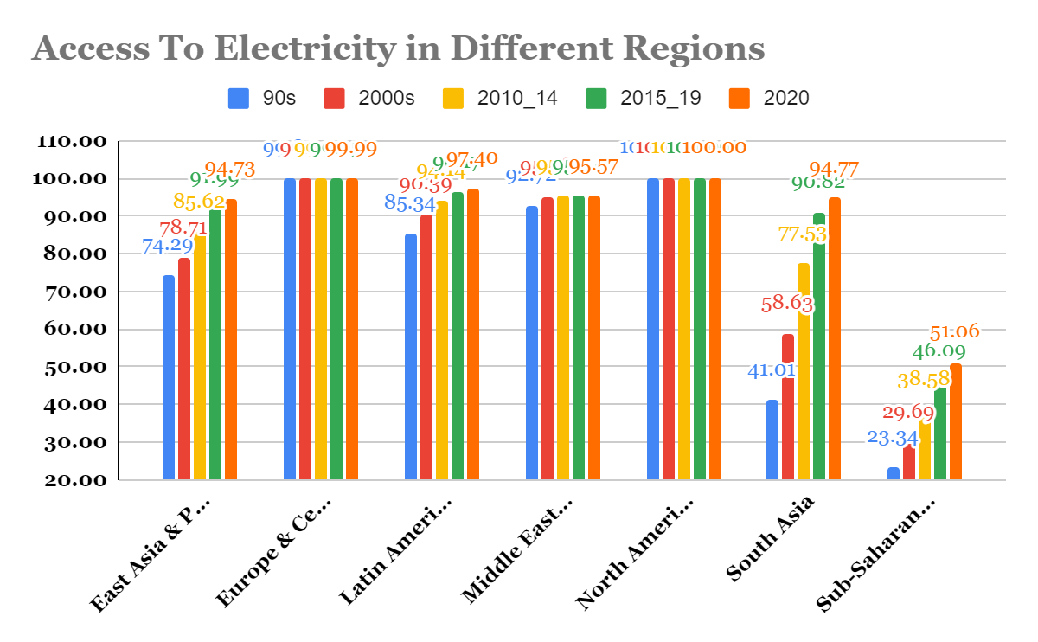
What we see, it becomes!

Slide 6
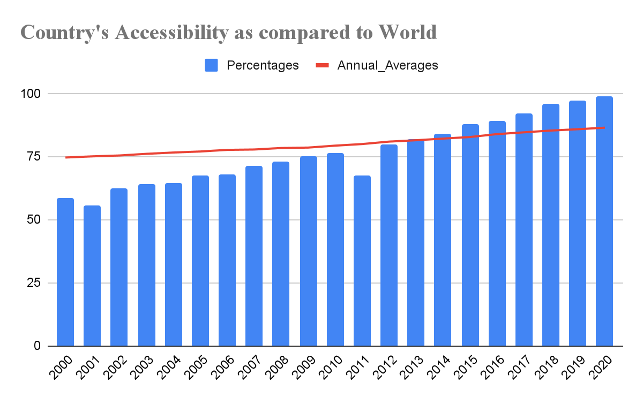
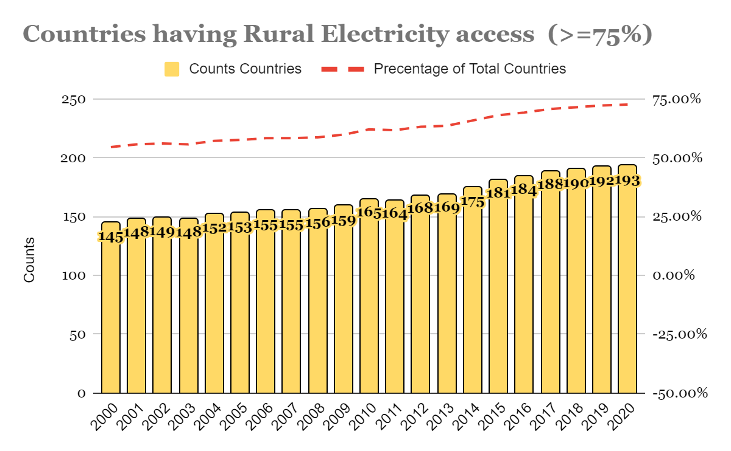
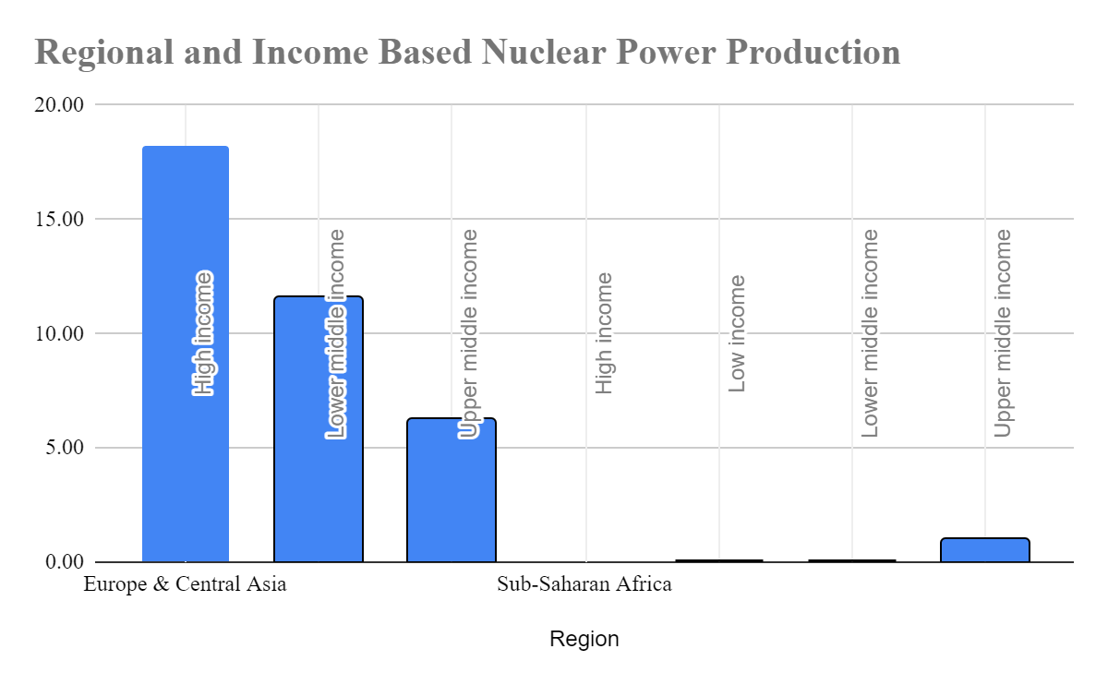
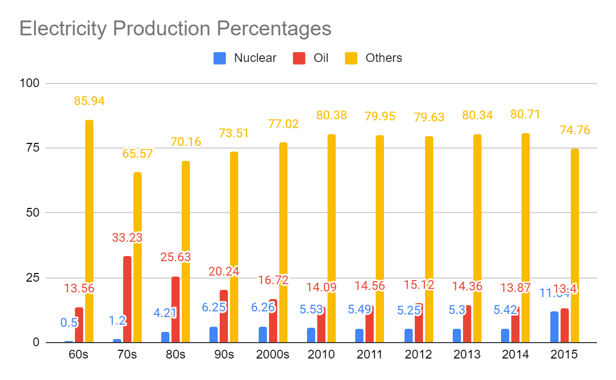

Slide 7

Problem Statements?
Comparison of access to electricity post 2000s
A way to compare every country’s performance with respect to world average for every year.
A chart to depict the increase in count of country with greater than 75% electricity access in rural areas across different year.
Define a way/KPI to present the evolution of nuclear power presence grouped by Region and Income Group.
A chart to present the production of electricity across different sources (nuclear, oil, etc.) as a function of time

Slide 8

What We Got?
We were able to get the comparison of access to electricity post 2000s

Slide 9
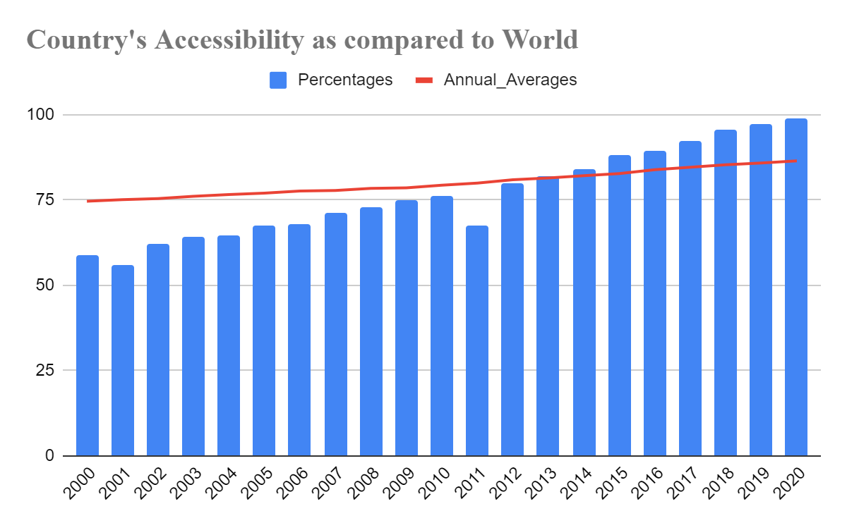
The chart is dynamic and any country’s performance can be checked with respect to world average for any year. (Currently showing of India’s.)
There is a significant growth in the count of countries where access to electricity rural areas was greater than 75% for different years. Yet the count till 2020 is still below 75% in terms of overall countries.

Slide 10
The evolution of nuclear power presence in different Regions and Income Groups shows that the evolution is majorly based in the West and powerful nations and countries with lower economic conditions are trying to catch-up. (The chart is showing comparison between Europe & Central Asia and Sub-Saharan Africa)
The production of electricity across different sources (nuclear, oil, etc) has changed in a considerably over the period of time, however the move towards the other sources is clearly evident, so as to have a Greener and Affordable Sources

Slide 11
Takeaway and Insights

Slide 12
The chart shows that there is a drastic rise in Nuclear Power production till 70s then it got stand still.
Why?
What happened in 70s?

Slide 13
In 1971 IMO, in association with the International Atomic Energy Agency (IAEA) and the European Nuclear Energy Agency of the Organization for Economic Co‑operation and Development (OECD), convened a Conference which adopted a Convention to regulate liability in respect of damage arising from the maritime carriage of nuclear substances.
The purpose of this Convention is to resolve difficulties and conflicts which arise from the simultaneous application to nuclear damage of certain maritime conventions dealing with shipowners' liability, as well as other conventions which place liability arising from nuclear incidents on the operators of the nuclear installations from which or to which the material in question was being transported.
The 1971 Convention provides that a person otherwise liable for damage caused in a nuclear incident shall be exonerated for liability if the operator of the nuclear installation is also liable for such damage by virtue of the Paris Convention of 29 July 1960 on Third Party Liability in the Field of Nuclear Energy; or the Vienna Convention of 21 May 1963 on Civil Liability for Nuclear Damage; or national law which is similar in the scope of protection given to the persons who suffer damage.
Source:IMO Website, Centre for International Law
1971 Convention: Transportation of Nuclear Goods

Slide 14
Thank You!

